Slide 1

Vel Tech Rangarajan Dr. Sagunthala R&D Institute of Science and Technology
School of Computing
Department of Computer Science and Engineering
10211CS224 / FULL STACK APPLICATION DEVELOPMENT (JAVA)
PROJECT REVIEW : MILESTONE PROJECT – 1
Date: 25-03-2026
Full-Stack Skill Learning Academy Marketplace with Secure Authentication
SDG: SDG No – SDG 4 – Quality Education
Presented By:
BINGAMALLA HANVITHA – VTU25643– 23UECS1026
Courses Handling Faculty:
Dr. S. HEMAMALINI, M.E., Ph.D.
Assistant Professor

Slide 2
INTRODUCTION
1
In today’s digital world, online learning platforms are widely used for skill development.
However, many small-scale systems lack proper structure, security, and user management.
This project focuses on developing a full-stack web application for a Skill Learning Academy.
It allows users to register, login, and view courses dynamically.
The system uses modern technologies like React, Node.js, and MongoDB.
It ensures secure authentication and efficient data handling.
This project demonstrates real-world application of full-stack development.
It helps improve accessibility to learning resources.
2
3
4
5
6
7
8
9

Slide 3
PROBLEM STATEMENT
1
Many existing learning systems are not fully automated and lack secure authentication.
Manual handling of user data leads to inefficiency and errors.
There is no centralized system to manage courses and users effectively.
Users face difficulty in accessing course information dynamically.
Also, data security is often not properly maintained.
Therefore, there is a need for a simple, secure, and automated system for managing online learning platforms.
2
3
4
5
6
7
8
9

Slide 4
OBJECTIVE(S)
1
To design and develop a full-stack skill learning platform
To implement secure user authentication using JWT and bcrypt
To store and manage user and course data in MongoDB
To display courses dynamically on the frontend
To improve efficiency and reduce manual data handling
2
3
4
5
6
7
8
9

Slide 5
PROPOSED SYSTEM
1
Provides user registration and login
Uses secure authentication (JWT, bcrypt)
Stores data in MongoDB
Displays courses dynamically
Reduces manual work
Improves data accuracy
Scalable and efficient system
User-friendly interface
2
3
4
5
6
7
8
9

Slide 6
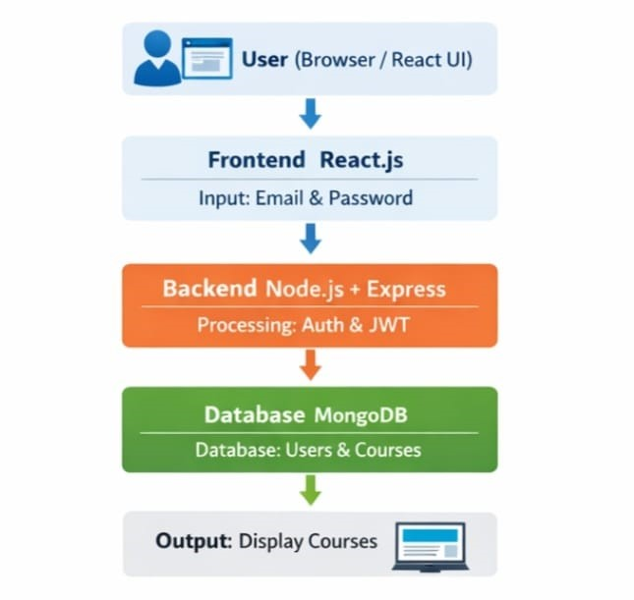
PROPOSED SYSTEM ARCHITECTURE
1
2
3
4
5a
6
7
8
9

Slide 7
PROPOSED SYSTEM ARCHITECTURE
1
Input:
User enters email & password
Processing:
Backend validates user
Authentication using JWT & bcrypt
Database:
Stores users and courses
Output:
Displays courses on UI
2
3
4
5b
6
7
8
9

Slide 8
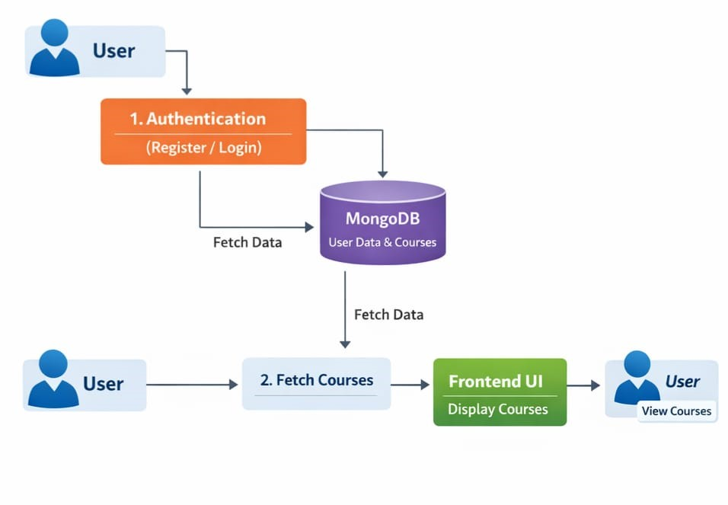
WORKFLOW
1
2
3
4
5
6
7
8
9

Slide 9
TECHNOLOGIES USED
1
2
Frontend: React.js
Backend: Node.js, Express.js
Database: MongoDB
Tools: VS Code, Postman
Requirements: Laptop, Internet, Node.js
3
4
5
6
7
8
9

Slide 10
MODULE DESCRIPTION
1
Module 1: User Management:
Handles user registration and login
Validates user input data
Encrypts passwords securely
Stores user details in database
Module 2: Authentication & Authorization:
Verifies user credentials
Generates JWT token for security
Controls access to system
Prevents unauthorized usage
2
3
4
5
6
7
8a
9

Slide 11
MODULE DESCRIPTION
1
Module 3: Course Management:
Stores course details in database
Retrieves courses dynamically
Displays courses on frontend
Supports easy course updates
Module 4: Backend Processing:
Handles API requests from frontend
Implements business logic
Processes user data
Connects frontend and database
2
3
4
5
6
7
8b
9

Slide 12
MODULE DESCRIPTION
1
Module 5: Database Management:
Stores user and course data
Uses MongoDB for data handling
Performs CRUD operations
Ensures data consistency
Module 6: Frontend Interface:
Provides user-friendly UI
Accepts user input
Displays course information
Communicates with backend APIs
2
3
4
5
6
7
8c
9

Slide 13
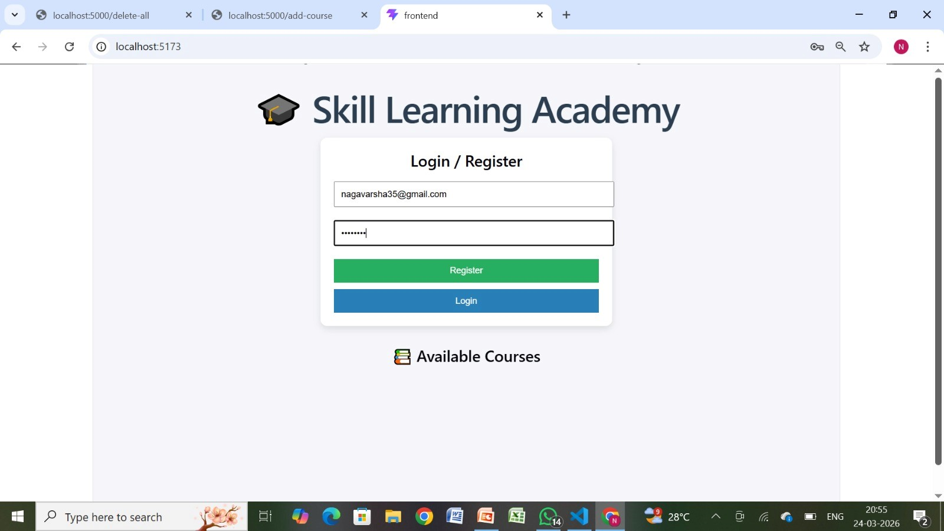
IMPLEMENTATION SCREENSHOTS
1
2
3
4
5
6
7
8
9a

Slide 14
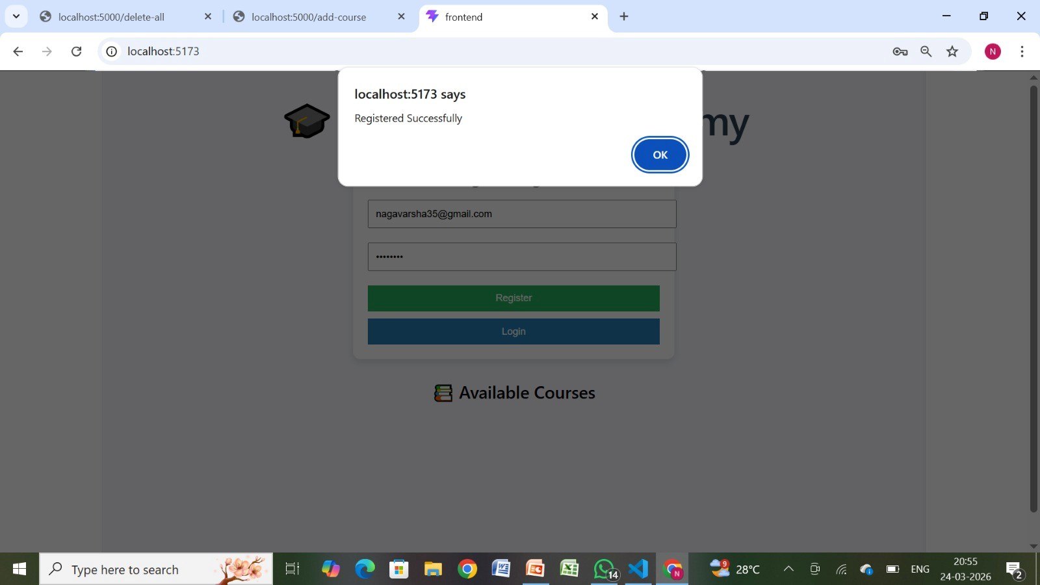
IMPLEMENTATION SCREENSHOTS
1
2
3
4
5
6
7
8
9b

Slide 15

IMPLEMENTATION SCREENSHOTS
1
2
3
4
5
6
7
8
9c

Slide 16
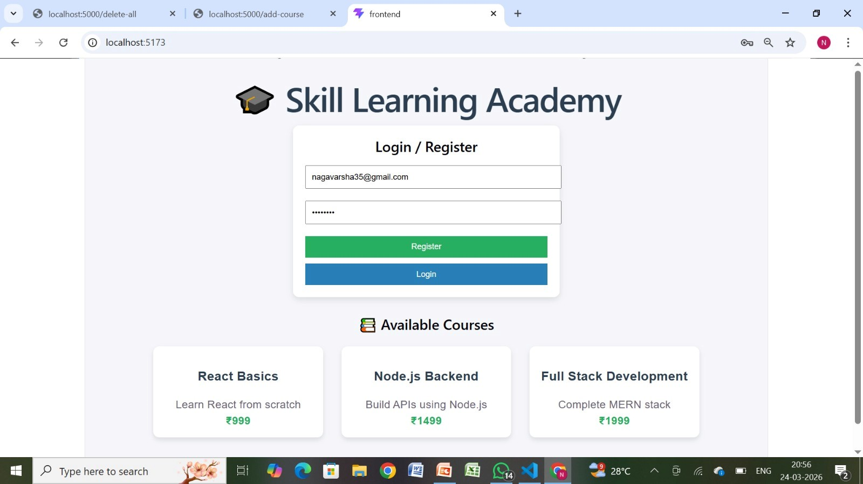
IMPLEMENTATION SCREENSHOTS
1
2
3
4
5
6
7
8
9d

Slide 17
ADVANTAGES & LIMITATIONS
1
Advantages:
Secure authentication
Dynamic data handling
Easy to use
Scalable system
Limitations:
No payment integration
Basic UI design
Limited features
2
3
4
5
6
7
8
9
10

Slide 18
Thank you

